Slide 1

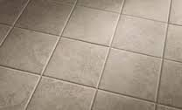
welcome

Slide 2

Teacher Name:
Samsun Nahar
172 No Middle Naogaon Govt ,P,S Matlob(south) Chandpur

Slide 3


Unite:5(commands)
Lesson:1-3

Slide 4

Learning Outcomes:
1)Following simple commends and instruction.
2)Students look the picture and speaking the words.
3)Students read the words.
4)Students write the words
Learning Outcomes:
1)Following simple commends and instruction.
2)Students look the picture and speaking the words.
3)Students read the words.
4)Students write the words.

Slide 5
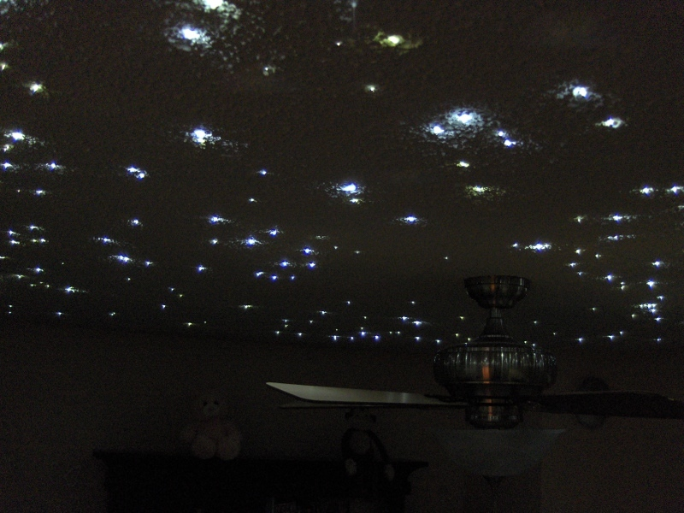
Safe envermant:
How are you?
Sing a song(Twinkle……..)

Slide 6

Lesson Declaration:
Now start our lesson—Commands.

Slide 7
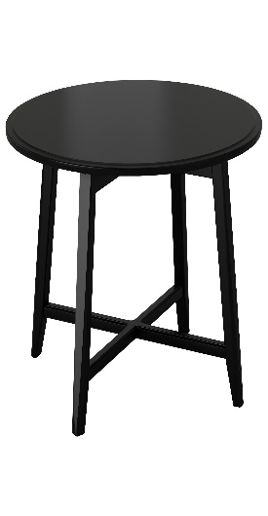


What can you see?
book
Table
Bag
Book

Slide 8
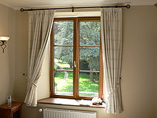
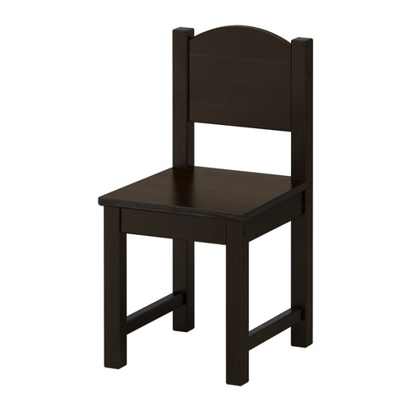

What can you see?
Chair
pencil
window

Slide 9

What can you see?
Door
Floor

Slide 10
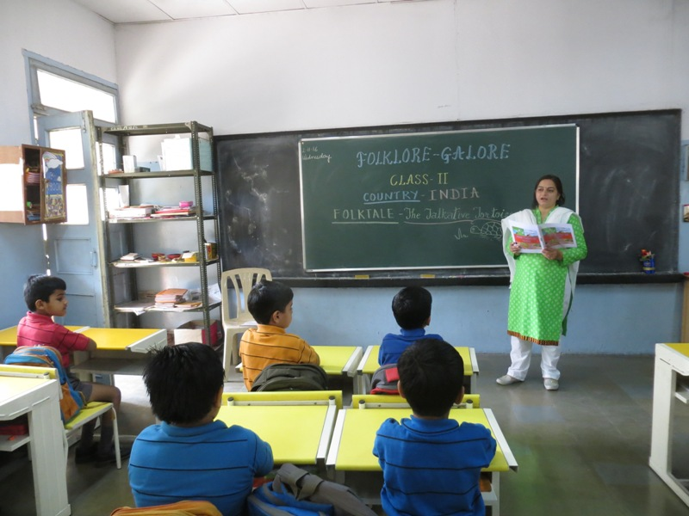
Teacher loud reading with correct pronunciation:
Window
Table
Door
Bag
Chair
Floor
Book
Pencil

Slide 11



Group Work
Door
Window
Book

Slide 12
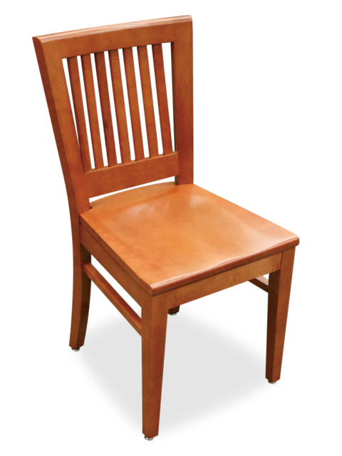
Write work
Chair
Floor
Bag

Slide 13

Write work
Pencil
Chair
Bag

Slide 14

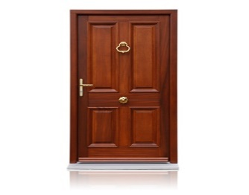

Matching picture with words:
Book
Door
Bag

Slide 15
Fill in the gaps:
c
D)pen___il
a
A)Ch______ir
o
E)Do______r
b
G)Flo______r
B)Ta_______le.
0
C)B________ok.
a
o
F)B___g

Slide 16
Students say
What’s this ?

Slide 17

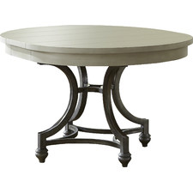
Students say

Slide 18

Time is End.
Thank you students
See you again next class
Bye Bye

